Slide 1

An assignment on Chemistry and Technology of maize

Slide 2
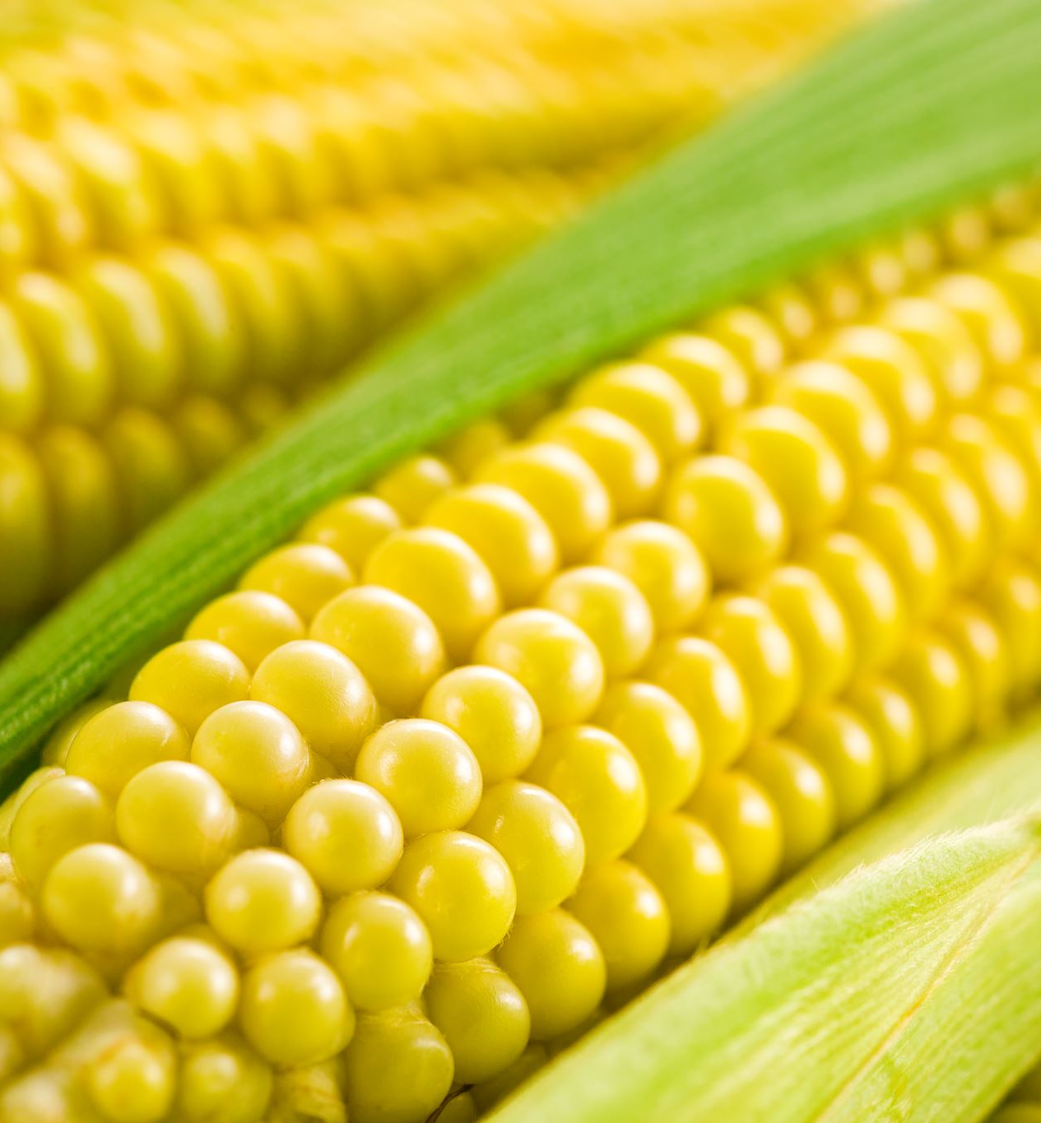
Introduction to Maize
Maize, also known as corn, is a cereal grain first domesticated by indigenous peoples in southern Mexico about 10,000 years ago. It is one of the most widely grown crops worldwide, both in temperate and tropical regions, and is among the 10 most important world crops by value

Slide 3
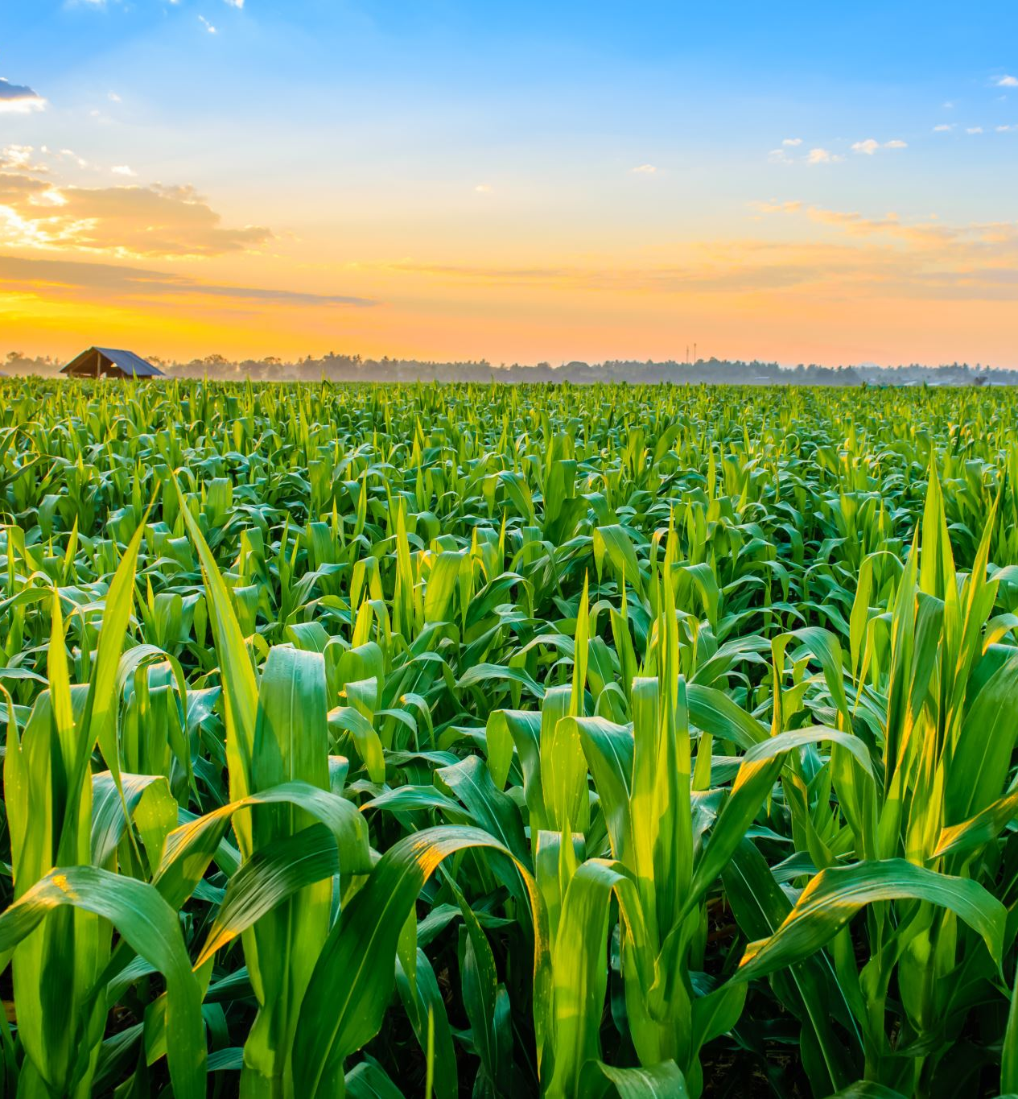
Background of Maize
The history of modern-day maize begins at the dawn of human agriculture, about 10,000 years ago. Ancient farmers in what is now Mexico took the first steps in domestication. Maize is a member of the Poaceae family and has a close relative, teosinte, which was domesticated in the same region around 10,000 years ago

Slide 4
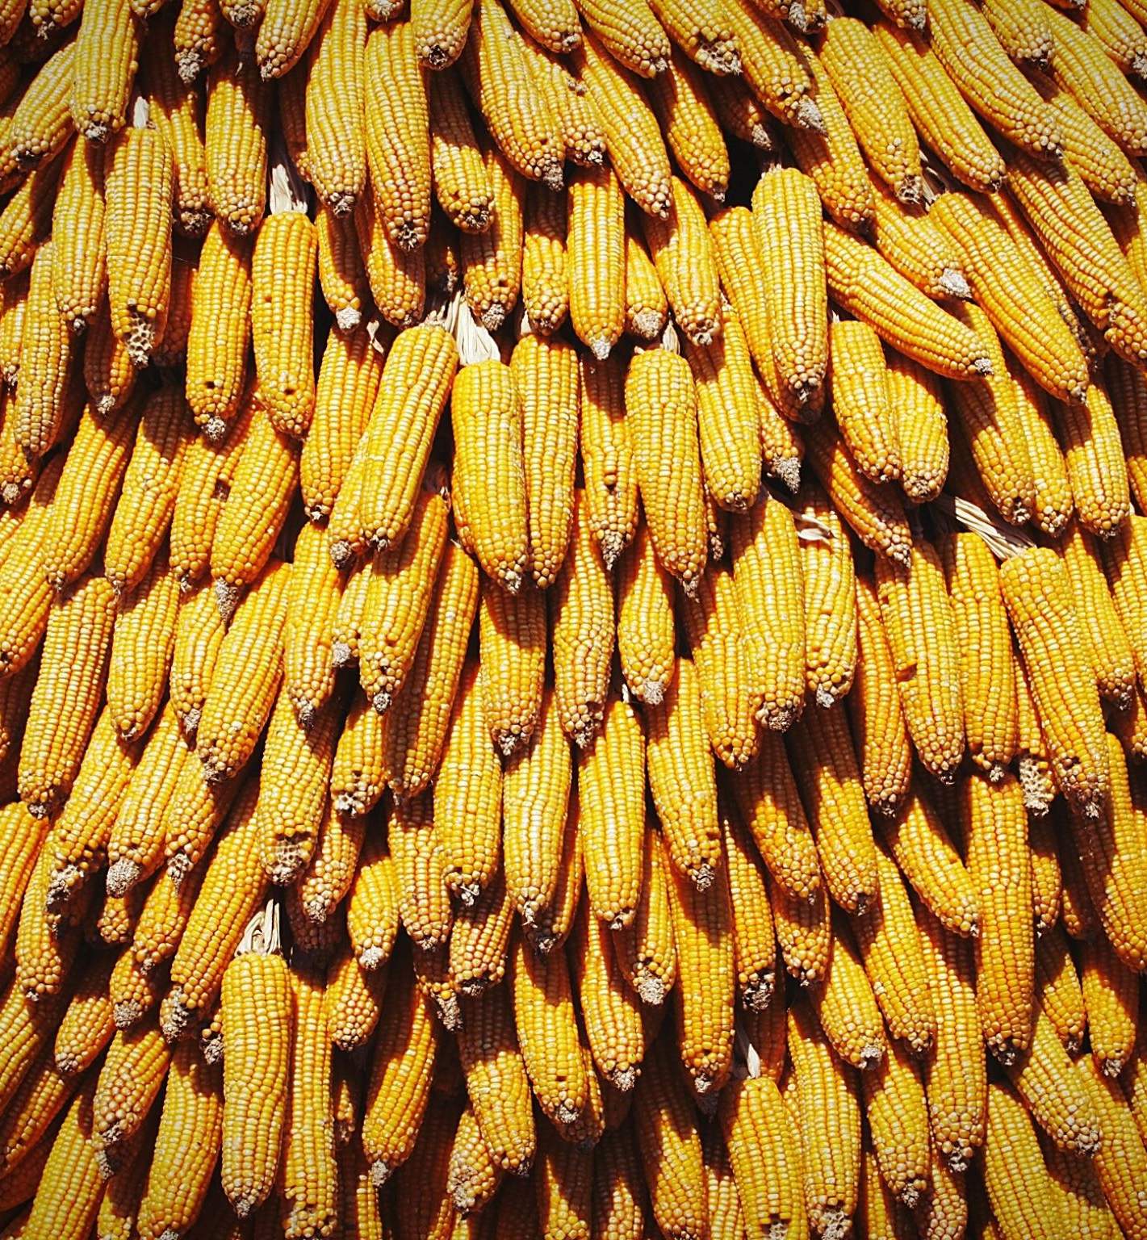
Composition of Maize
The major chemical component of the maize kernel is starch, which provides up to 72 to 73 percent of the kernel weight. Other carbohydrates in maize include simple sugars, cellulose, and lignin. The predominant mineral in maize is potassium, followed by sodium, calcium, and magnesium. Maize also contains essential vitamins and minerals, making it a nutritious food source.

Slide 5
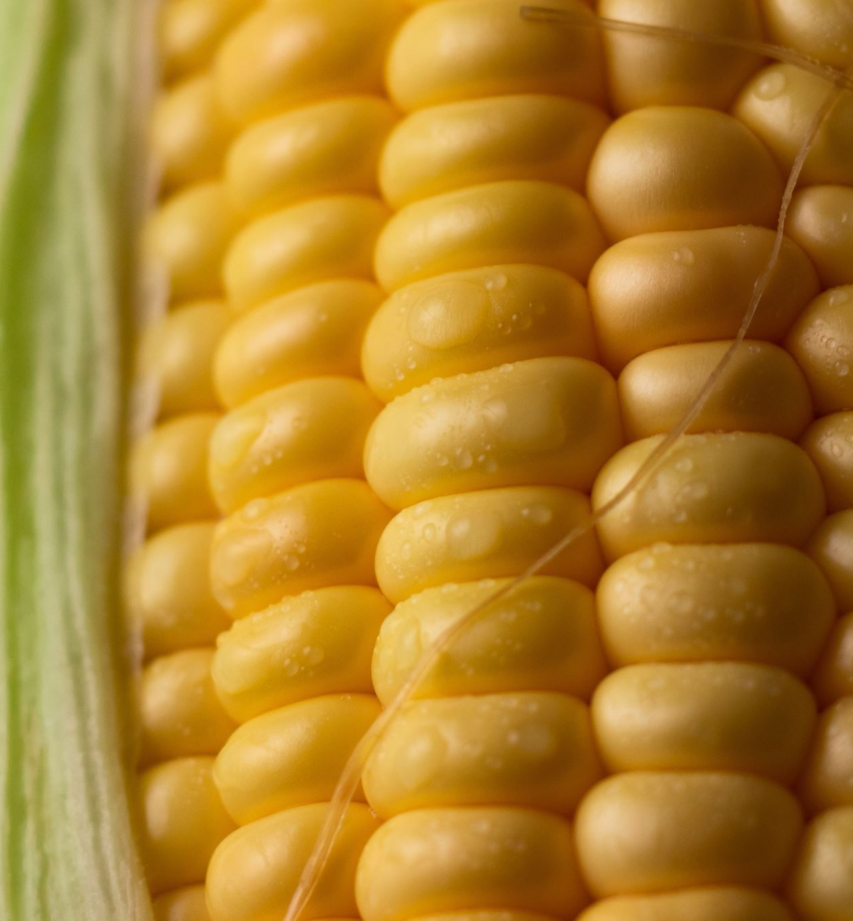
Physical Properties of Maize
The physical properties of maize grains, such as size, sphericity, density, and moisture content, can vary depending on the moisture content. These properties can affect the processing and preservation of maize products.

Slide 6
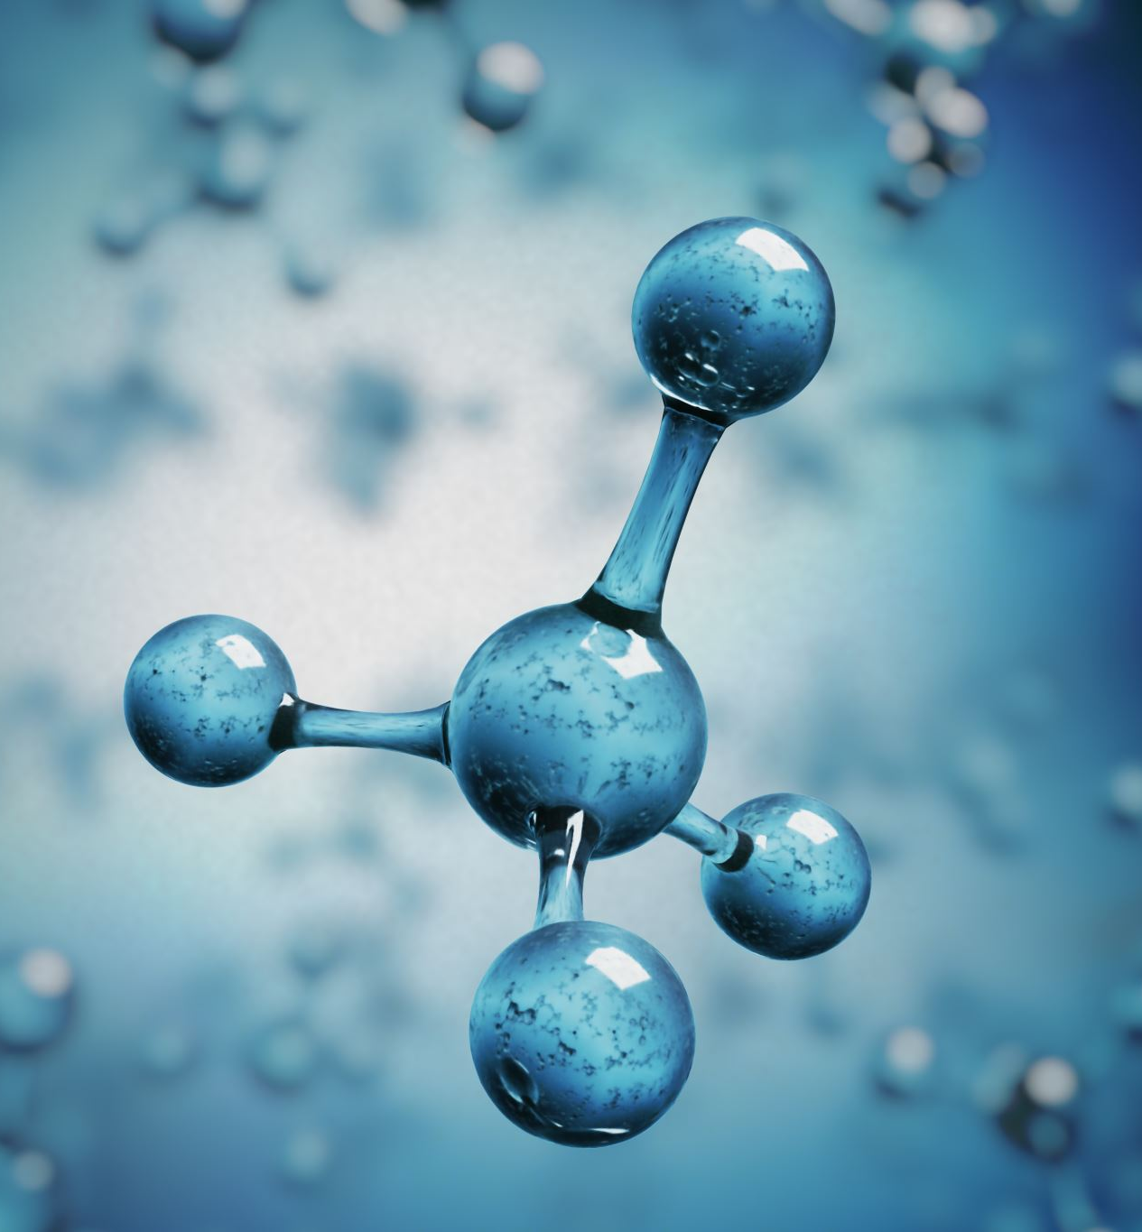
Chemical Properties of Maize
Maize contains various chemical compounds, including carbohydrates, proteins, fats, and dietary fiber. The chemical composition of maize mucilage, a byproduct of the milling process, consists mainly of carbohydrates, with up to 97% (w/w) of mucilage being carbohydrates.

Slide 7
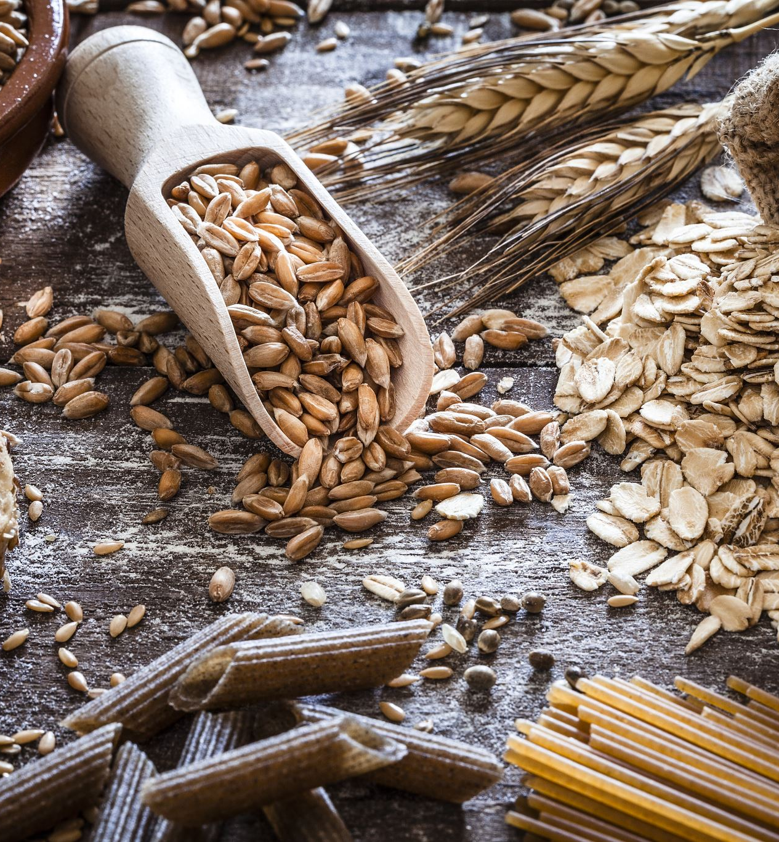
Processing of Maize
Maize can be processed in various ways, such as grinding into flour, popping into popcorn, or fermenting for alcohol production. The processing method depends on the desired end product and the specific properties of the maize variety.

Slide 8

Preservation of Maize
Proper storage and preservation of maize grains are essential to maintain their quality and prevent spoilage. This includes maintaining the right temperature, humidity, and oxygen levels to ensure the longevity of the product.

Slide 9
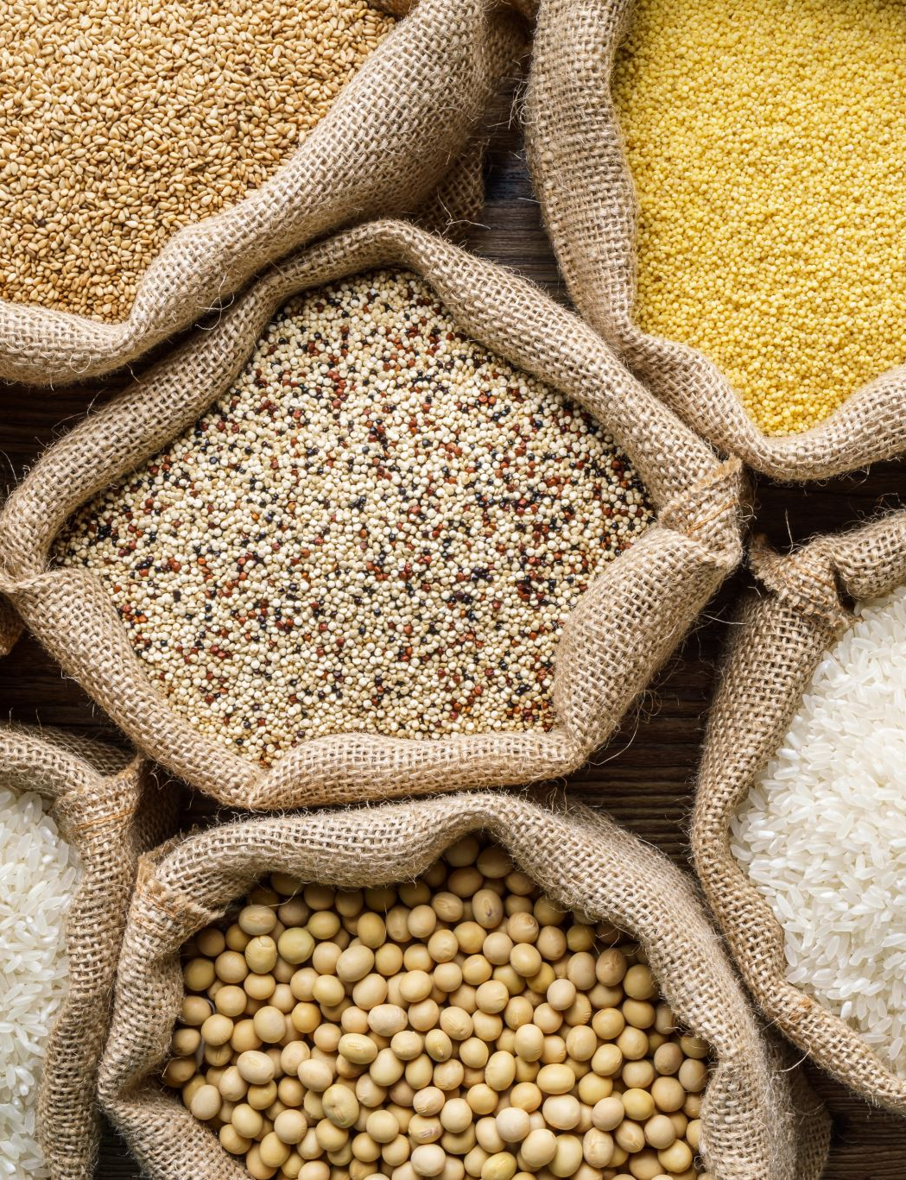
Food Value of Maize
Maize is a valuable food source, providing essential nutrients such as carbohydrates, proteins, fats, and dietary fiber. It is used in various forms, such as flour, oil, and feed, making it a versatile ingredient in human nutrition and animal feed.

Slide 10

Factors of Deterioration
The deterioration of maize can be influenced by various factors, including moisture content, temperature, and storage conditions. Proper storage and handling practices can help minimize the risk of spoilage and ensure the quality of the product.

Slide 11

Storage of Maize
To store maize effectively, it is important to consider the moisture content, temperature, and storage structure. Proper storage of maize is crucial to maintain its quality and prevent spoilage. Monitoring the moisture content, temperature, and using appropriate storage structures are key factors in ensuring the longevity of stored maize.

Slide 12

Thank You

